Slide 1
What do we do? How do we do it? Why do we do it?
Plot to Pot!

Slide 2
What is Plot to Pot!
Plot to Pot club (P2P) runs on a Tuesday after school for 1 hour.
Up to 30 children attend the sessions which are run by Miss Young and Mrs Jackson
Our mission is to grow food and find wild food and then cook it or prepare it for us to eat.

Slide 3
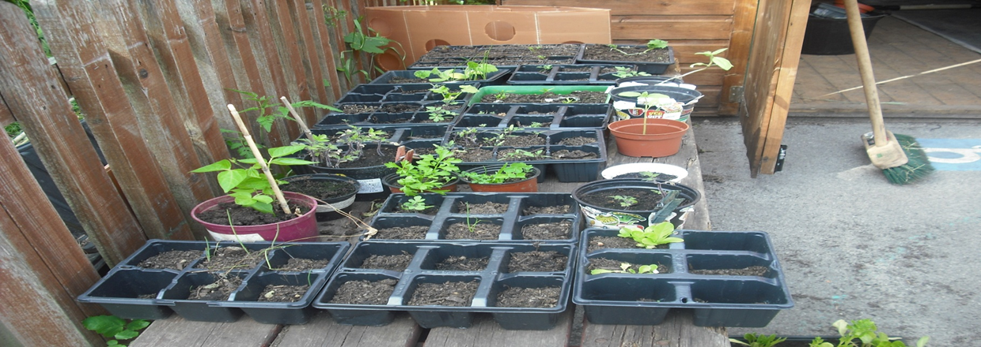
It is hard work and good exercise!

Slide 4
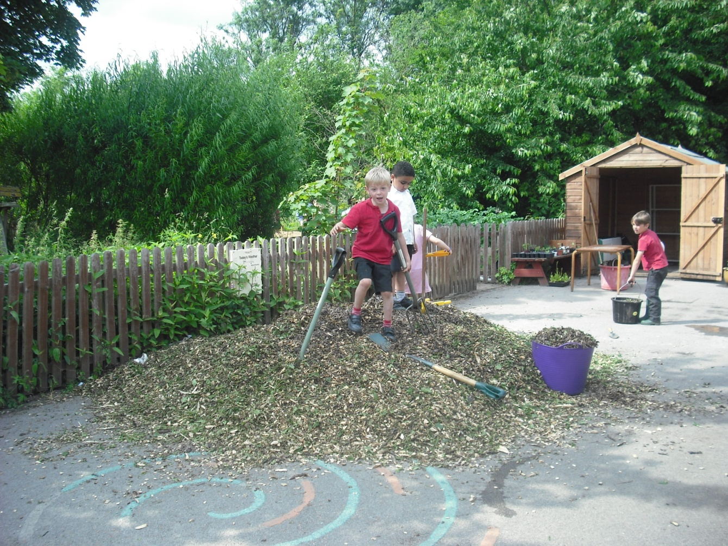
It is great fun and we work as a team

Slide 5
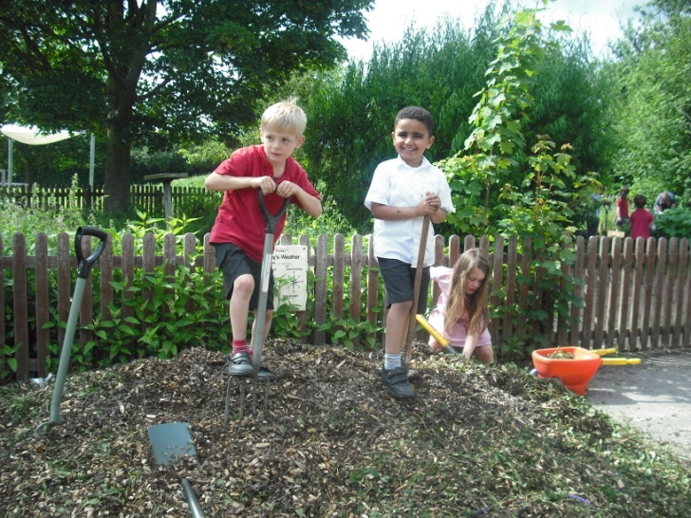
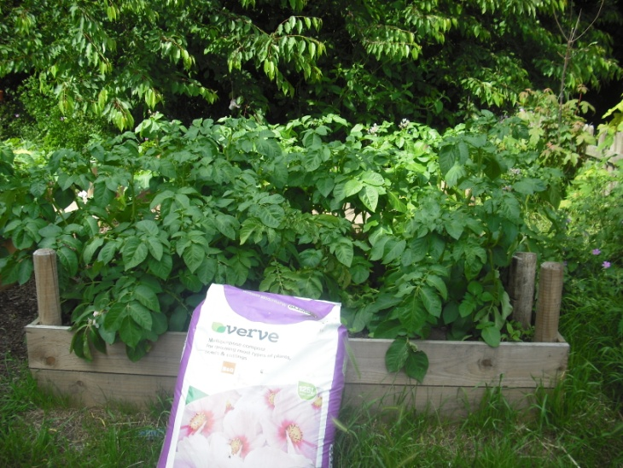
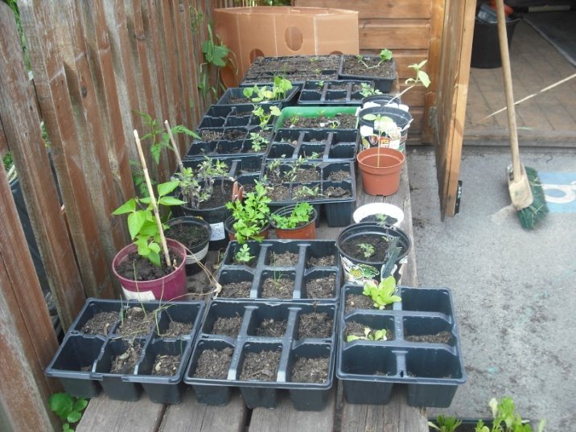
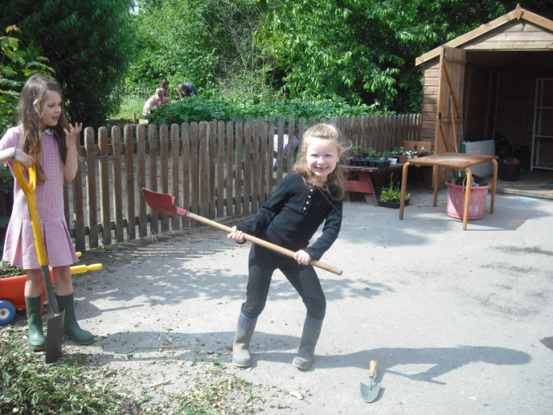

Slide 6
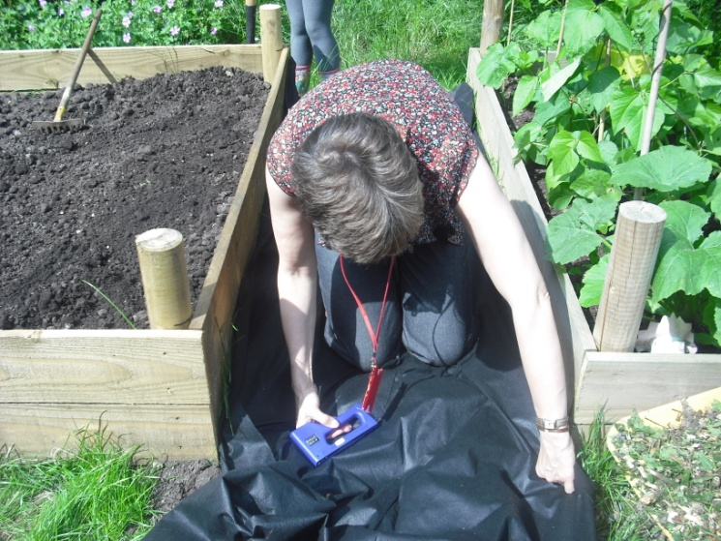
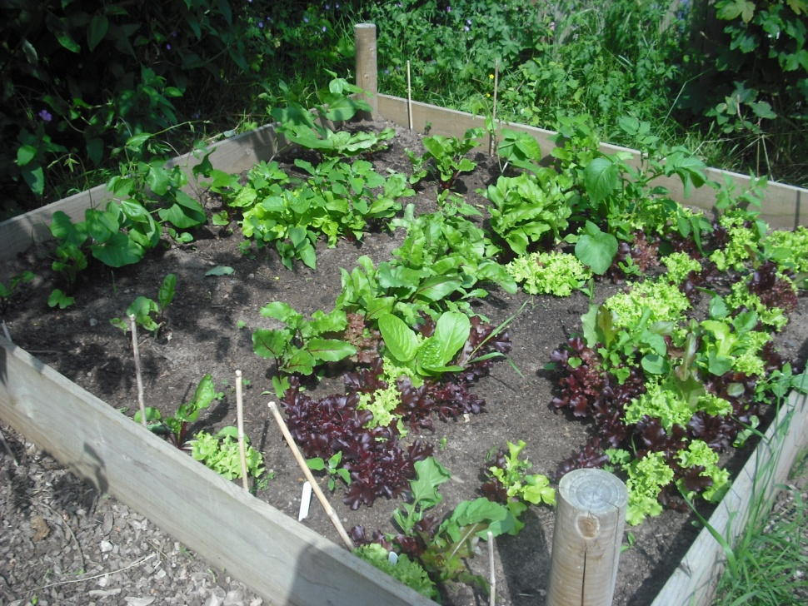
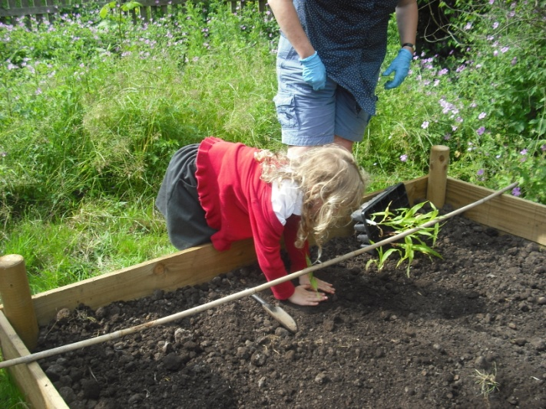
We grow everything from lettuces to pumpkins!

Slide 7
What we have grown:
Potatoes Tomatoes
Carrots Strawberries
Lettuce Raspberries
Onions Courgettes
Radishes Beans
Cabbage Peas
Pumpkins Herbs

Slide 8
What we have cooked and eaten
Jams, relishes, mincemeat
Vegetable soup
Salads
Apple crumble
Sandwiches
Elderflower cordial

Slide 9
We interviewed members of the club and this is what they said …
What would you change?
We need more tools (Sonny)
Nothing – its perfect (Lisa)
Rewards for our hard work (Joshua)
Its perfect (Emily)
And messy! (Alexander)
More time to do it and more cooking (Evie A)
Biscuits for break time (Matthew)
Grow more vegetables (Lucy)
I’d like a pond (Jenson)

Slide 10
What’s your favourite thing about P2P?
Weeding! (Emily W)
Digging and planting (Lisa)
Getting my hands dirty (Emily G)
Harvesting and eating (Samantha)
Everything! (Jack)
Seeing this grow (Connor)

Slide 11
As the person who started it, we asked Mrs Jackson what she thinks about P2P
I think it is really important that children understand where their food comes from and how it grows.
Our local area is full of food that we ignore and waste and yet we eat food that is brought from all over the world.
Children need fresh air and exercise and not everyone enjoys sports, so this is a good way to keep fit.
Eating is very sociable, so its like having a party every Tuesday!

Slide 12
Rights Respecting
Article 24:
Every child has the right to the best possible health. ….nutritious food and a clean environment.
Article 31:
Every child has the right to relax, play and take part in a wide range of cultural and artistic activities.

Slide 13
What do we get out of the club?
Exercise
Fresh Air
Fun/friendship
Connecting with food
Understanding plants
Understanding nutrition
Understanding how to prepare food
Trying new and interesting foods
Respecting the natural world
Improving the environment by:
- Making it more attractive
- Providing habitats for other animals – biodiversity
- Reducing food miles

